Slide 1
Term 3 Week:1- notes
Concentration of solutions

Slide 2
Concentration of solutions
The concentration of a solution is defined as the quantity of solute dissolved in a quantity of solution; this can be represented in a variety of ways, including by the number of moles of the solute per litre of solution (mol L⁻¹) and the mass of the solute per litre of solution (g L⁻¹) or parts per million (ppm)
The concentration of a solution describes the relative amount of solute and solvent present in the solution.
A solution in which the ratio of solute to solvent is high is said to be concentrated. A solution in which the ratio of solute to solvent is low is said to be a dilute solution.

Slide 3
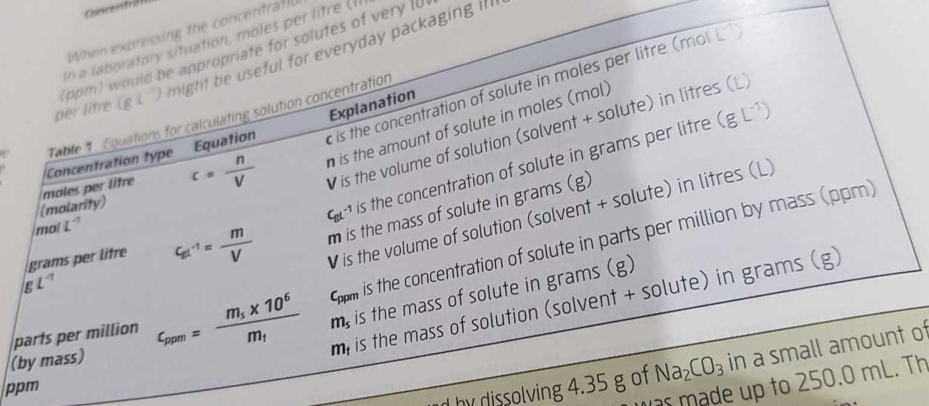
Calculating solution concentration

Slide 4
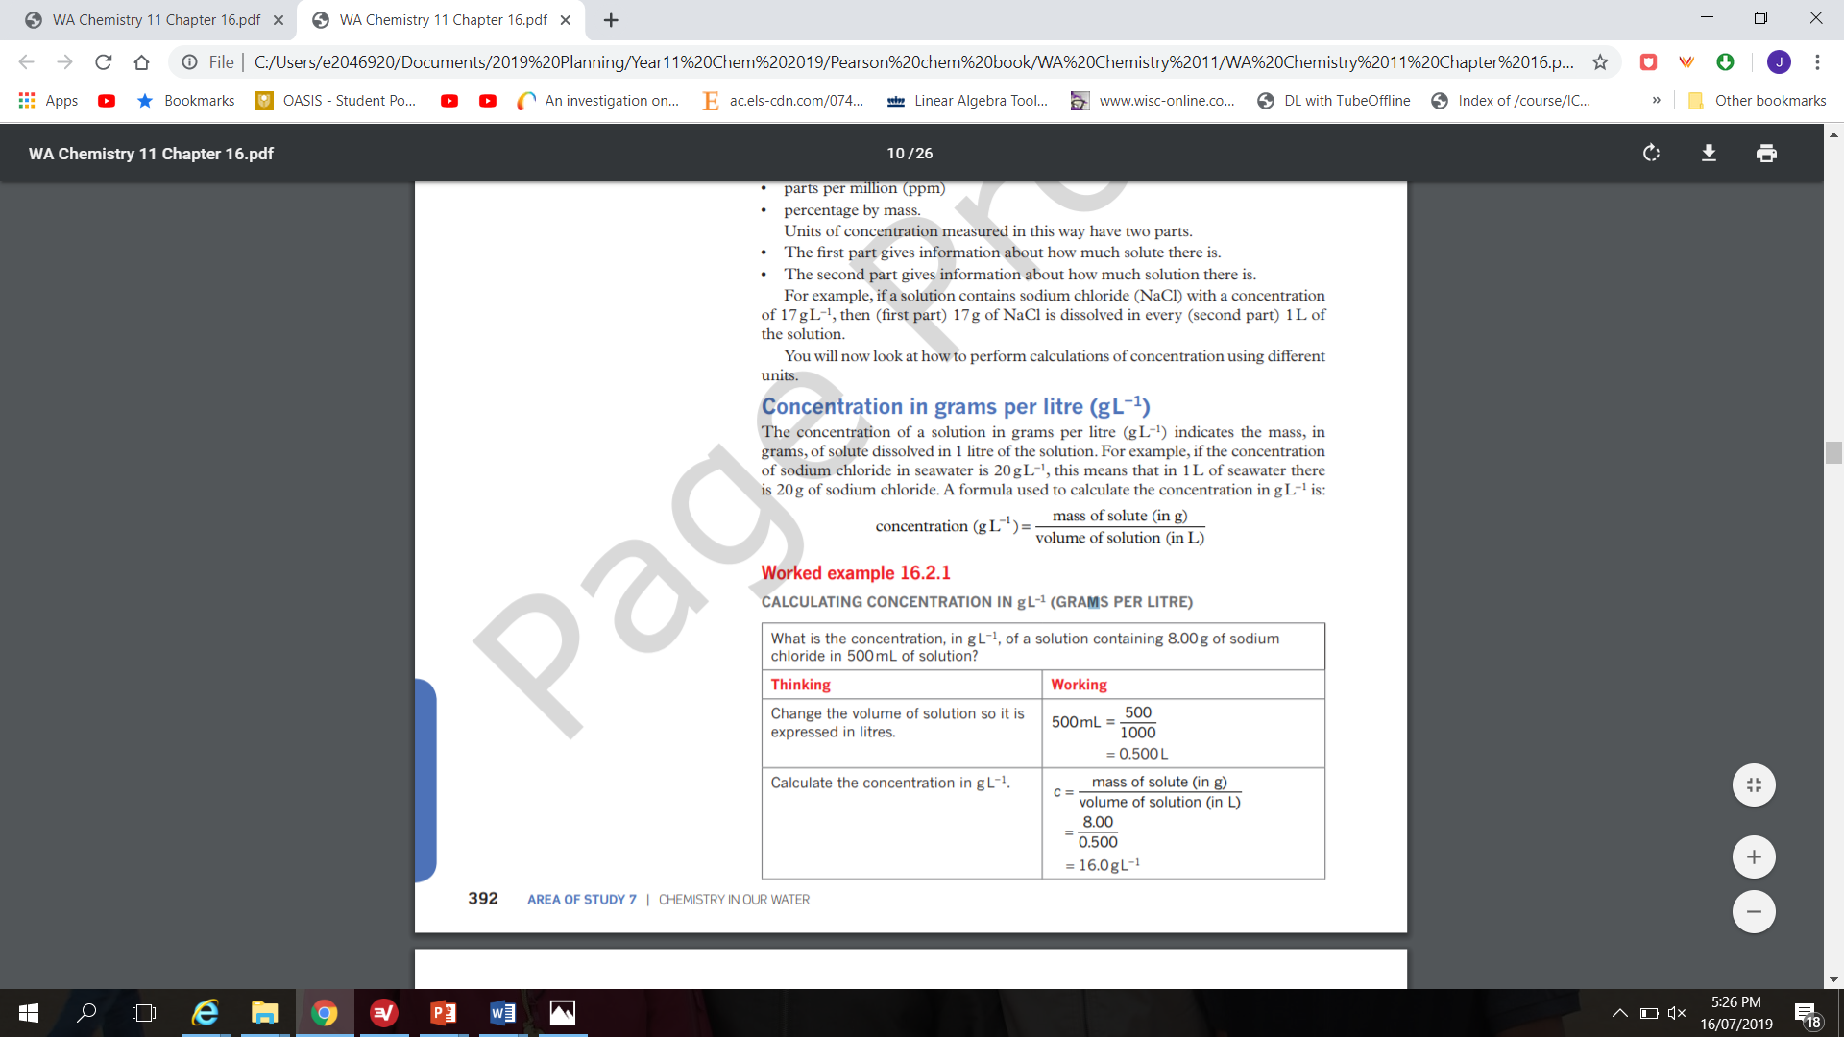

Slide 5
Practice question on calculating concentration in gL⁻¹
Calculate the concentration, in g L⁻¹, of a solution containing 5.00g of glucose in 250mL of solution.

Slide 6
Concentration in parts per million (ppm)
When very small quantities of solute are dissolved to form a solution, the concentration is often measured in parts per million (ppm).
The concentration in parts per million can be thought of as the mass in grams of solute dissolved in 1000 000 g of solution. This can also be expressed as the mass in milligrams of solute dissolved in 1 kg of solution, because there are 1 million milligrams in a kilogram.
Concentration (ppm) = mass of solute (in mg) ÷ mass of solution (in kg)

Slide 7
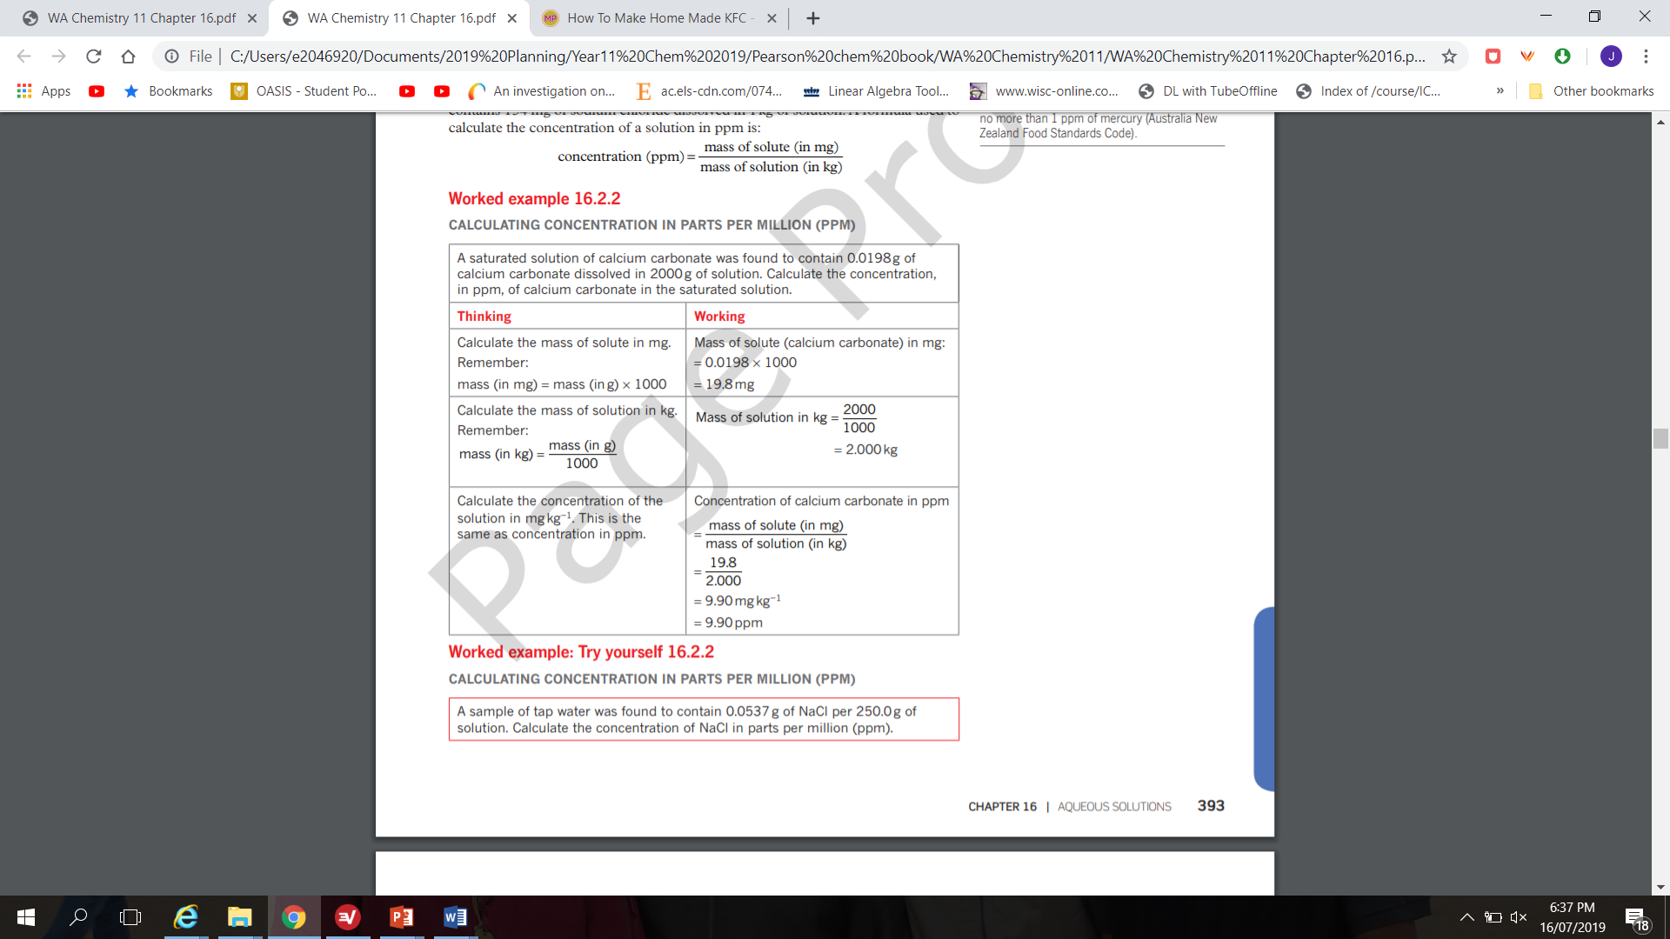

Slide 8
Practice question
A sample of tap water was found to contain 0.0537 g of NaCl per 250 g of solution. Calculate the concentration of NaCl in parts per million.

Slide 9
Molar concentration
The concentration of a solution in moles per litre is often referred to as the molarity or molar concentration of the solution. It has the unit molL⁻¹ which is sometimes represented as M.
A solution containing 1 mole of solute dissolved in 1 litre of solution can be described in several different ways. You can say that the solution:
has a concentration of 1 mole per litre
has a concentration of 1 molL⁻¹
^{is 1 molar}
^{is 1M}
^{has a molarity of 1M}

Slide 10
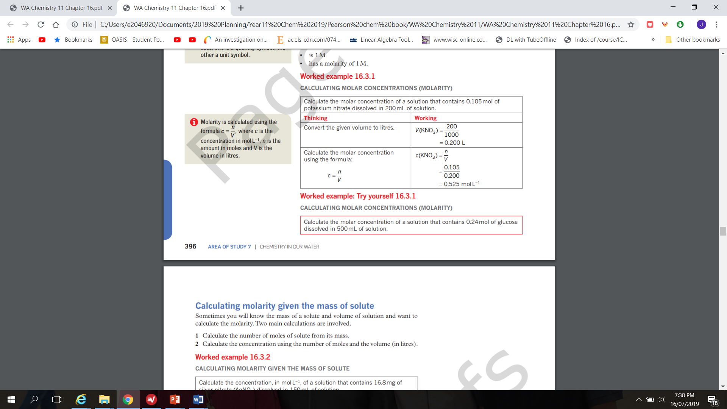

Slide 11
Practice question Calculating molar concentrations ( Molarity)
Calculate the molar concentration of a solution that contains 0.24 mol of glucose dissolved in 500 mL of solution.

Slide 12
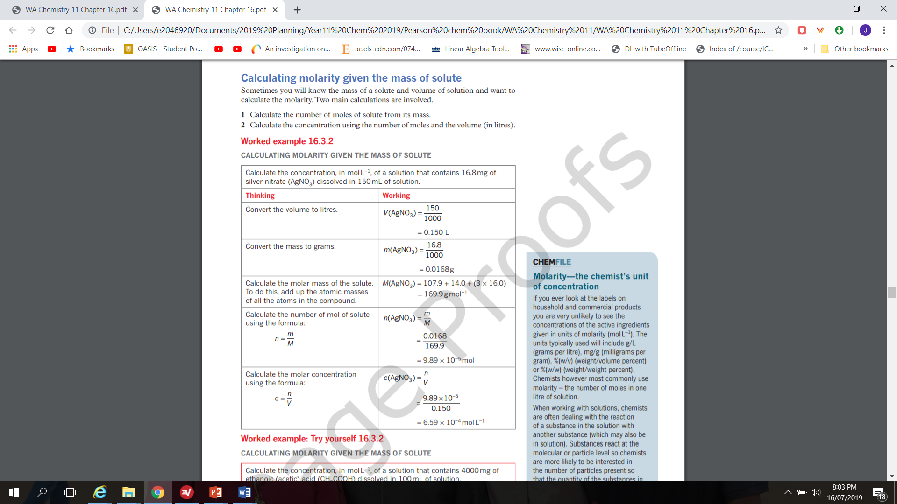
Calculating molarity given the mass of solute

Slide 13
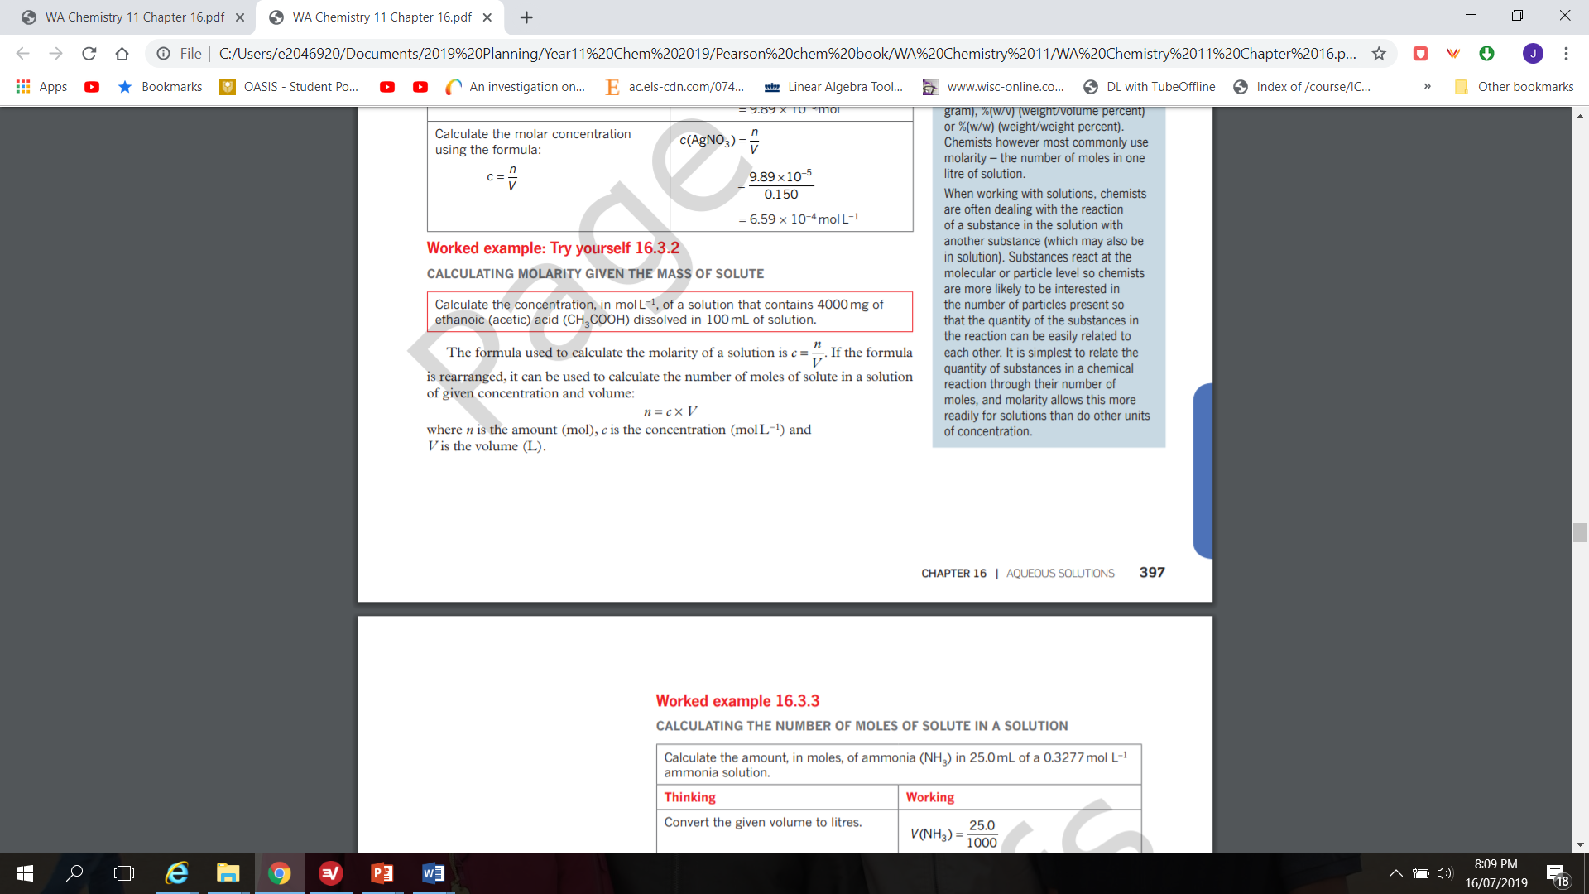

Slide 14
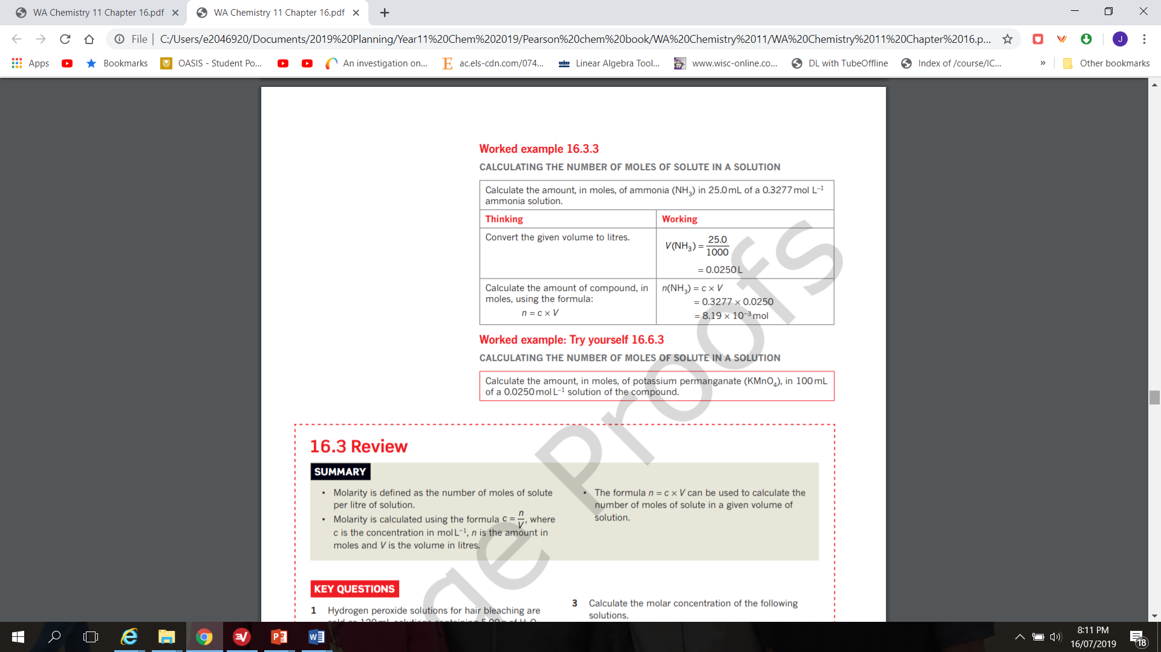

Slide 15
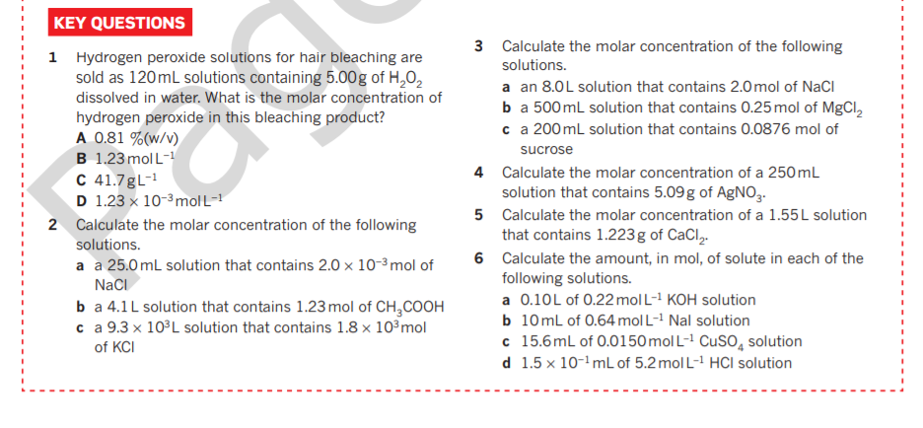

Slide 16
Questions to complete
Year 11 ATAR Exploring Chemistry text: Set31: Page: 175 Q’s: 1,3,7

